Slide 1


Introduction to Animal Movement Analyses
Resource Selection Function Models
Jared A. Stabach, PhD
Research Ecologist
Terrestrial Lead – Movement of Life Initiative
Conservation Ecology Center
Smithsonian’s National Zoo &
Conservation Biology Institute
Grab and Image
Many thank to Dr. Joe Kolowski for sharing his notes and collaborating on these lectures. Additional Smithsonian-Mason School of Conservation training courses can be found at:
https://smconservation.gmu.edu/programs/graduate-and-professional/
Notes:
In this lecture, we’ll start to move towards answering questions about the landscapes characteristics that govern the movements of animals. This, of course, builds off of Qianru’s lecture on annotating your dataset with various remote sensing variables (i.e., building a spatial data frame) that are appropriate to answer your questions of interest. One of the primary reasons researchers fit animals with tracking devices is to understand these species habitat relationships, because we recognize that animals choose their habitats to maximize their fitness. So, finding areas that provide various resources, decrease the probability of mortality, and increase the chance of finding mates.
Importantly, resource selection function models provide predictions of habitat suitability and are often used in habitat corridor analyses among other things.
These models, however, can get quite complex. It’s important to know the assumptions of these models and how to apply them. So, we’ll be starting with basic resource selection function models, but I’ll be providing links to other references and resources so that those of you that are most interested in these types of models can investigate future.

Slide 2

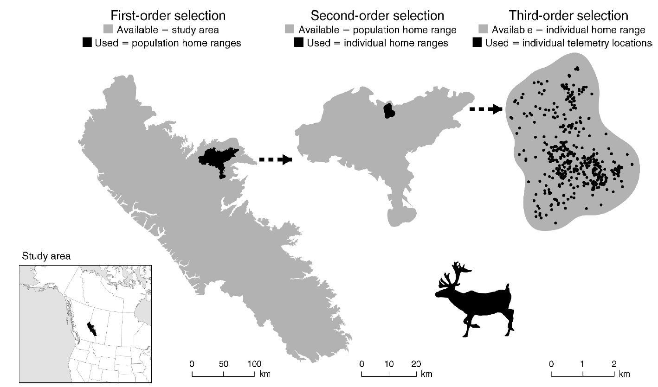
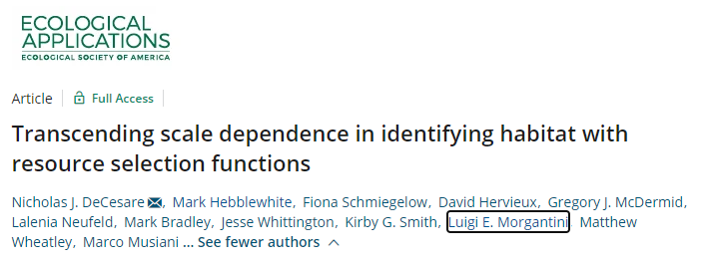
Orders of Selection
Different scales of inference
Fourth-order selection: Local habitat selection (individual steps)

Slide 3
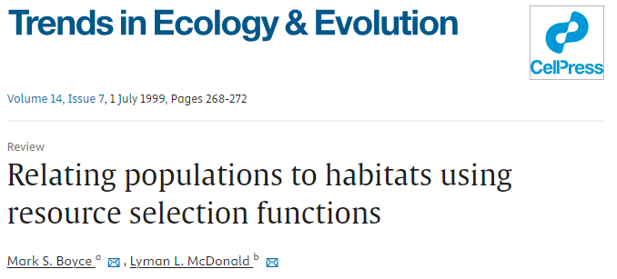
Resource Selection Function Modeling
Boyce and McDonald 1999. Relating populations to habitats using resource selection functions.
Compare environmental covariates at used locations to those at a set of locations assumed to be “available” to the animals
Perhaps better referred to as “Habitat Selection Functions” (HSFs)
Based on models for spatial point processes
Coefficients (and strength of selection) typically estimated with logistic regression models (binomial GLM)
These models approximate point process models under certain conditions

Slide 4
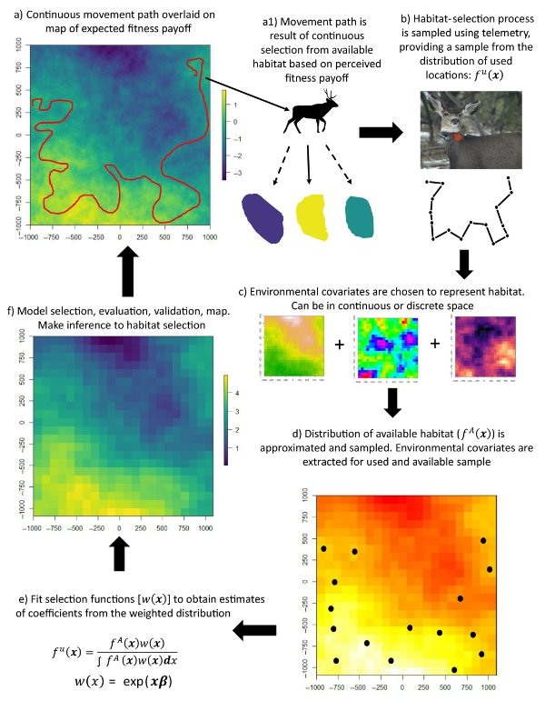

Identify habitat features preferentially used or avoided
Infer ecological needs and limitations
Generate expected distribution maps
Inform demographic projections in support of species/landscape management

Slide 5
Notes:
Continuous movement path

Slide 7
Notes:
We sample that distribution by fitting an animal with a tracking device.

Slide 8
Notes:
We then select a number of covariates, either continuous or discrete

Slide 9
Notes:
Use

Slide 10
Notes:
We then fit a selection function, to get model coefficients. Model selection and

Slide 11
Notes:
Finally, we’ll finish with a spatial prediction.

Slide 12
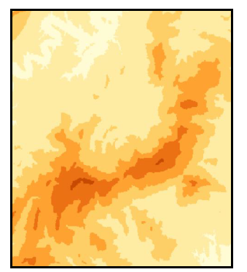
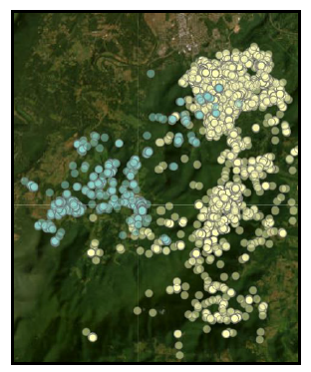
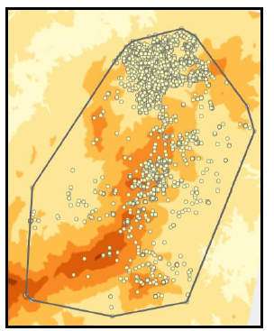
The Data
Environmental Covariates
Where to acquire?
How to represent variables?
Tracking Data (‘Use’)
Autocorrelation
Error and fix failure
Sample size of relocations AND animals
Availability
What defines the area?
How many locations are enough?
Random or Regular?
Notes:
Qianru described a number of different options for relating your animal point data with some sort of remote sensing variable. This is where you really need to do some thinking about your research questions and how you might address them. Then, you need to determine what data are available. Of course, some of these data might not be available at the scale that you need. In this case, you might have to create your own data layer

Slide 13
Accessing Environmental Data
Various remotely sensed data sources available
E.g., Elevation, NDVI, Land-cover, Roads, Rivers
Possible to also create your own data layers to meet study objectives
E.g., Fine-scale human footprint, Fine-scale land-cover analyses, Distance to known water points

Slide 14
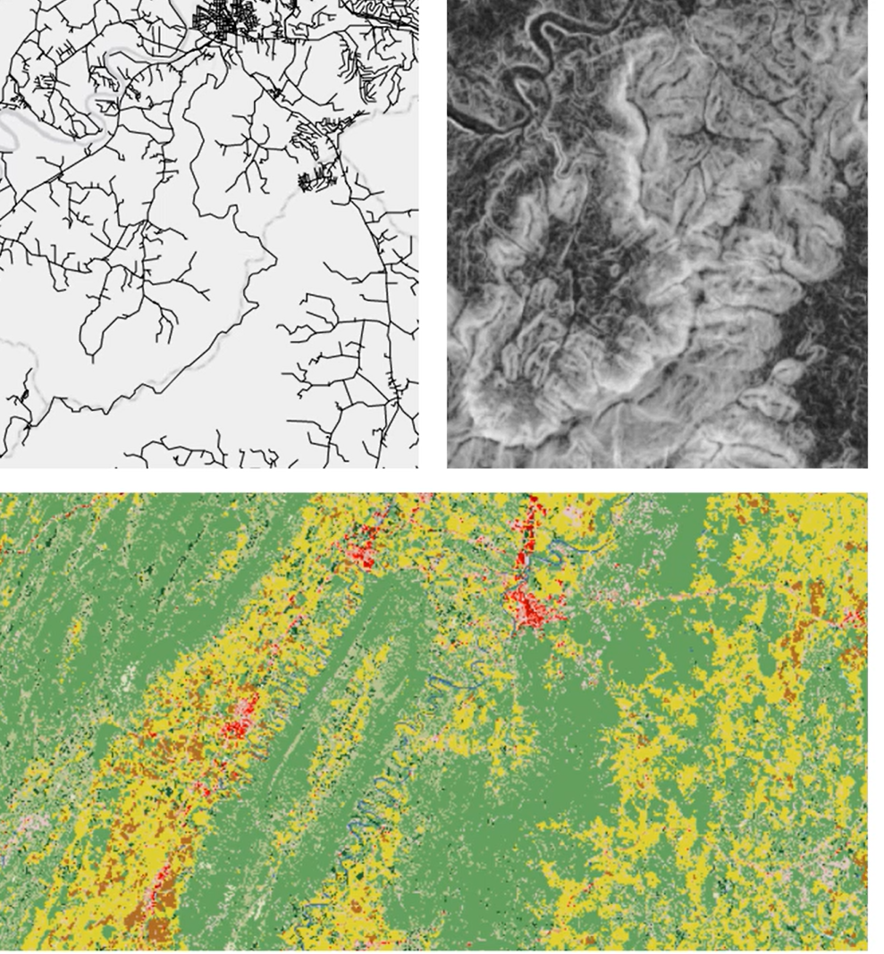
Characterizing the Habitat Landscape
Habitat distance vs Categorical variable
Categorical variables add parameters unnecessarily and provide reduced inference
Interest in specific habitat type?
The role of error in assigning habitat type
Raster vs Vector
Existing format of available data
Desire to have all data sources in the same format
Required by some packages like amt and ctmm
Desire to create a prediction map
I prefer using only continuous raster layers, and would recommend using the reflectance values from a sensor rather than a classified value

Slide 15

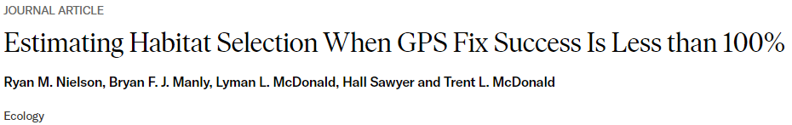
Tracking Data – Habitat-biased fix success
Reduced fix success rate in certain habitat can bias habitat modeling results
Solution 1: Correction factors may be developed and applied to GPS location data sets (Frair et al. 2004)
Calibration in multiple habitat types
Weights applied to recorded tracking data
Solution 2: Modeling habitat specific fix success probability (Nielson et al. 2009)
Similar to patch occupancy models
Fix success probability modelled separately from selection probability
Probability of detection Integrated Step Selection Function (PDiSSF; Vales et al. 2022)
PDiSSF package (Nielson and Lombardi 2022)

Slide 16
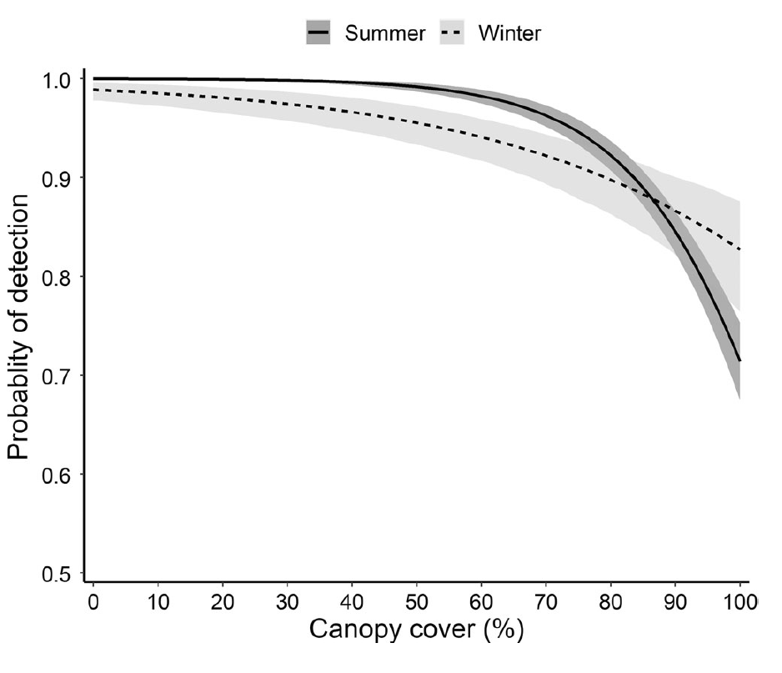
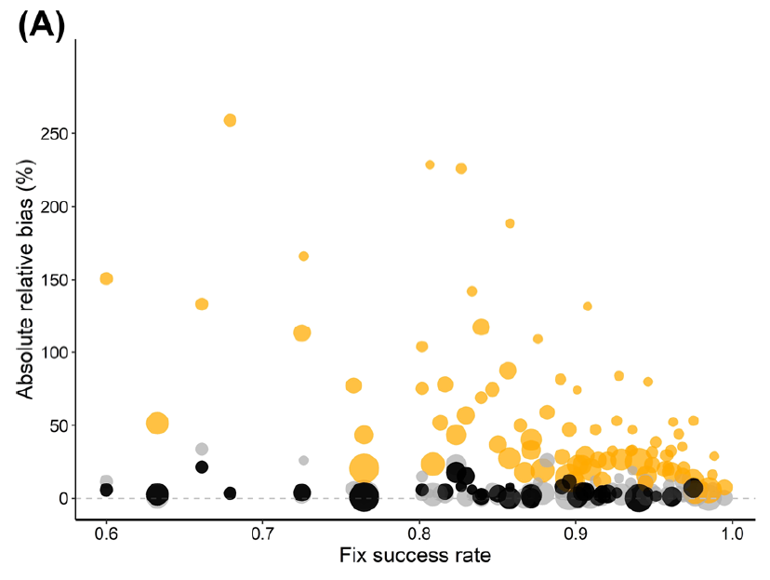

Notes:
You can see from the graph on the left, reported in Vales et al, that the probability of detection changes as the canopy cover increases. These are things that were recognize, since canopy and other features reduce the attenuation of the GPS signal. Importantly, we see that effect of canopy cover changes when comparing summer and winter periods.

Slide 17
Autocorrelation
Assumption of independent locations in standard RSF models
Will lead to underestimates of uncertainty/variance when data are autocorrelated
Potential solutions:
Thin data closer to improve independence
Use robust form of SE when describing uncertainty in population level parameters
Bootstrap method (Fieberg et al. 2020)
Newey West estimate (package: sandwich) – Nielsen et al. 2002
Ctmm::rsf.fit()
Step-selection functions to incorporate movement processes directly

Slide 18
Sampling Interval Regularity
Issue: Sampling interval influences inference – areas with higher sampling will appear more selected
Examples:
Differential day vs night sampling with differential day vs night habitat selection
Fix interval change later in season, when habitat selection has also changed
Solution:
Record at regular intervals or resample data to make the data ‘regular’
Notes:
The other issue that we want to think about is an irregular sampling interval. The problem with irregular samples is that areas that are sampled more frequently are likely to be over-represented in our dataset, thus biasing our result and effectively appearing like these areas are more selected than areas with lower sampling frequency. If this is happening completely randomly with respect to environmental variables, then it’s not a problem. But, for instance, we need to really understand if the pattern is random. For instance, you could have different sampling intervals between night and day, which could bias your results simply because you are collecting more points in day or night. Similarly, if you change fix interval while you are collecting data on your animals, it could result in greater preference for particular habitats and erroneously bias your regression coefficients.
The solution, of course, is to either collect data at regular intervals or resample your data to make the track regular, which is what we have done here with our wildebeest data.

Slide 19
How many relocations do I need per animal?
As many as possible
Assumed to be independent in RSF
Fewer locations needed when beta is high (strong selection)
BUT, if selection is VERY strong, highly specialized animal, may need a lot of more locations to observe at least SOME use of avoided habitats.
Some disagreement about relationship with landscape complexity
Street et al. 2021 find lower N needed with higher complexity
Notes:
One of the key questions to answer is that collecting as much data as possible, and more is better, while remembering that one of the key assumptions of our models are that data are independent. So, it’s not necessarily beneficial to collect more data if these data are more autocorelated if we can’t correct for this autocorrelation structure.
It’s generally been show that fewer locations
Complexity of the landscape also comes into play. Intuitively, this makes sense, since we’d need to appropriately sample from this complexity to get reliable inference. A recent paper, however, by Street et al….a paper which I’ve included in the publications folder found that lower sample sizes were needed, so some disagreement here.
There’s no real threshold for how much data should be collected. The most important point is adequately sampling the variability that exist across your study area.

Slide 20
Defining Availability – This is Critical
Critical decision point in RSF analyses
All habitat in available area must be truly available to the animal
Decision depends in part of desired inference from analysis
What area?
100% MCP – amt package
95% MCP
99% KDE (AKDE?)
Conduct sensitivity analysis with varying definitions of available area
Can likely defend decision based on behavioral ecology of the animal
Areas dependent on current location and movement behavior – SSF and variations
Notes:
Often, a simple MCP is used, mostly just because these are very quick to create. But should it be 100% or 95% MCP or 99% Kernel density estimate or perhaps a home range that has been calculated with CTMM. It’s important that any of these areas are not necessarily meant to provide an accurate depiction of an animals home range. Instead, this is just meant to provide a boundary to what is available to the animal and where we might want to sample.

Slide 21
How many available points do I need?
A lot and enough
Sufficiently large sample required to approximate a point process model
Sufficient size depends on animal, covariates, the ratio of use to availability…
• Computer time less limited than previously
• Current suggested approach:
Increase number of available points until estimated slope coefficients do not vary (Northrup et a. 2013; Fieberg et al. 2021)
Assign “infinite” weights to available points to reduce role of model specification (Fithian & Hastie, 2013)
• Regular or random points?
Regular likely better from a statistical sampling standpoint
Regular sampling one point per each raster unit an option (Street et al. 2021)
Notes:
Are seeing more recommendations for regular, versus random, sampling.

Slide 22
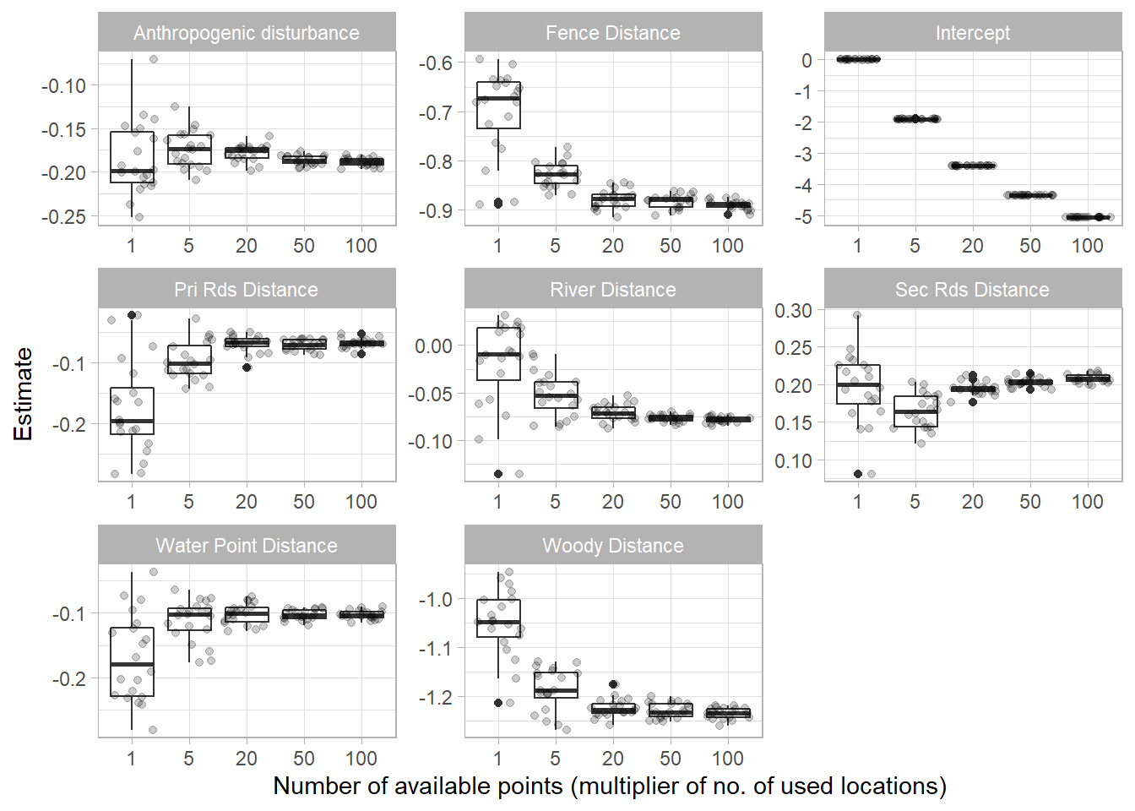

Grab graph of simulation
Grab graph of simulation

Slide 23
How many aanimals do I need?
Previous standard rule of thumb of > 30 (Leban et al. 2001)
Ignores the fact that many factors will influence selection strength, which determines required sample size
Landscape heterogeneity perhaps most critical
Street et al. 2021
Only declines with increase in Beta estimates (stronger selection patterns)
Depending on scenario, robust estimates may be feasible with lower samples than previously thought.
Analytical solution requires a priori knowledge of model coefficients and measure of landscape complexity (i.e., available area) as well as desired level of precision of estimates.

Slide 24
The modeling approach
Tracking (use) and random/regular locations (available) described well by a spatial Inhomogeneous Point Process (IPP) model
IPP is a model for random locations in space, where the expected spatial density of the locations depends on spatial predictors
The binomial likelihood of logistic regression differs from the conditional likelihood o the IPP model BUT
As the number of available points is increased towards infinity, the slope parameters in logistic regression models converge to the slope parameters in an IPP model (Warton and Shepherd 2010)
So we can use logistic regression! ….. Sort of…

Slide 25
Parameter Interpretation
Issue: Used and available locations not mutually exclusive (available habitat points may also be used)
Collected data is no longer a Bernoulli random variable
Ratio of used to available under control of the analyst as opposed to the process you are trying to describe
Probability of being a used point decreases with number of user-generated available locations
Solution: Modify our interpretation and application of logistic regression results

Slide 26
Changes from standard Logistic Regression
Interpretation of predicted probability inappropriate with use vs. available (not use vs. non-use, which would be a RSPF).
Intercept is biologicall meaningless
In IPP model it represents the baseline point density when covariates are = 0 (which is user determined with sampling intensity)
Focus on interpreting beta coefficients and resulting odds ratios as relative use intensity or relative probability of selection
Odds ratios termed Relative Selection Strength (RSS)

Slide 27
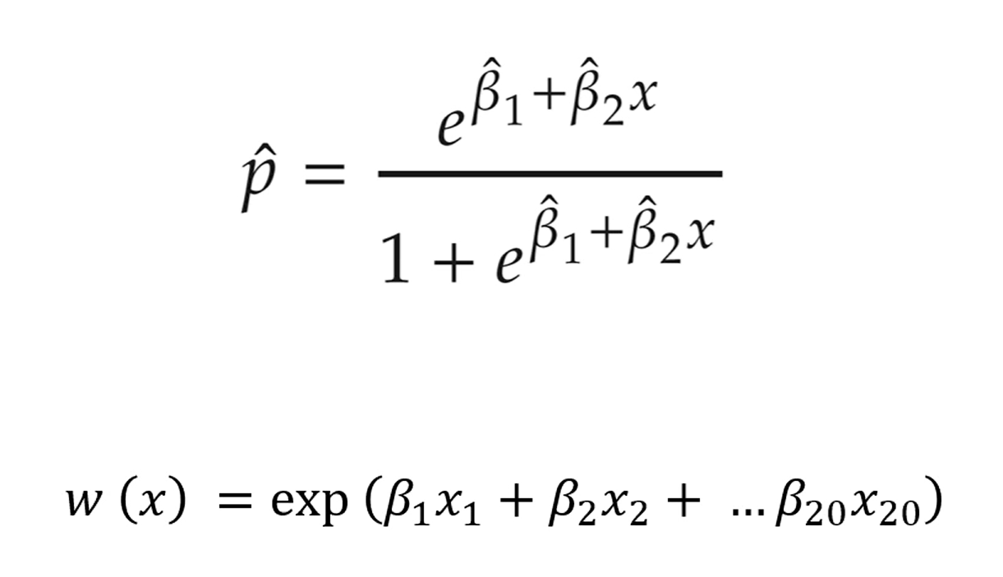

Slide 28
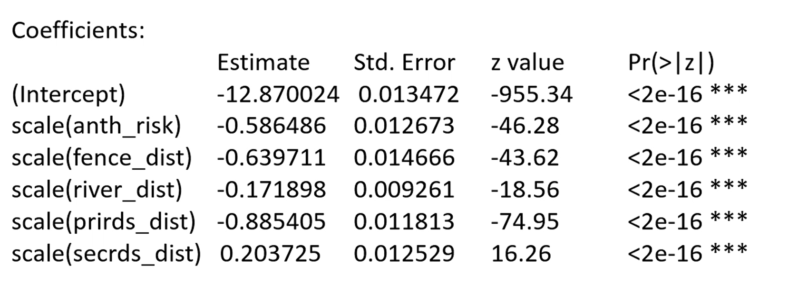

Slide 29
Interpreting Parameters
Odds ratio interpreted as relative selective strength (RSS) – Avgar et al. 2017
Relative intensity of use of two locations that differ by 1 unit of covariate (1 SD if covariates were scaled)
exp(β)
exp(0.303) = 1.35
“animal is 1.35 times more likely to choose location with 1 unit higher of this covariate”
exp(-0.183) = 0.833
“0.833 times more likely to choose a location with 1 higher value of covariate”
OR
exp(0.183) = 1.20
“1.20 times more likely to choose location with 1 lower value of covariate”
Different values assumed to be equally available and values for all other predictors are held constant

Slide 30
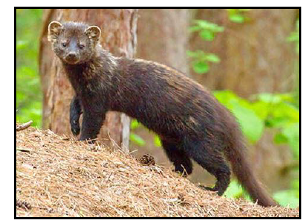
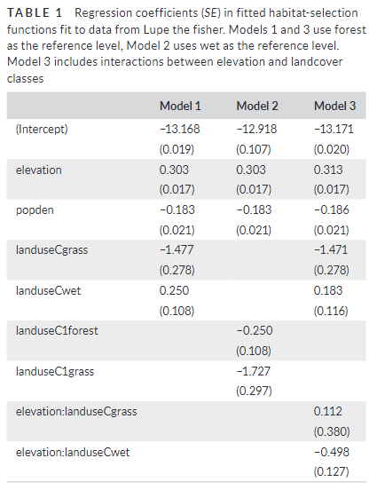
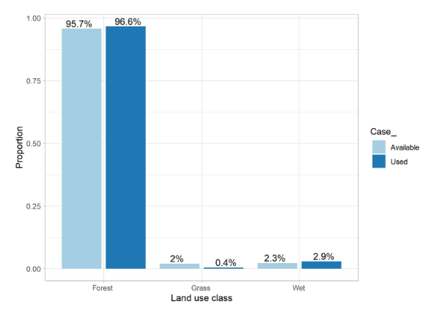

Categorical Parameters
Plots of use vs availability frequency distributions
Remember baseline category assignment
exp(0.250) = 1.28
1.28 * 0.023/9.957) = 0.03
1/0.03 = 33 times more likely to find an animal in forest than wetland

Slide 31
Model Selection
Multicollinearity should be addressed prior to model fitting
Variance inflation factor (VIF > 3.0)
Pairwise correlations (> 0.7)
Model parsimony not typically an issue and most complicated models often selected
Inference typically made from “full/global” model estimates and associated uncertainty
Model sets compared with information theoretic approaches (e.g., AIC) and similar metrics when necessary
E.g., testing polynomials or interactions, comparing utility of correlated predictors

Slide 32
Individual vs Pooled vs Random Effects
Pooled data across individuals
Available points within animal ranges pooled
One set of models
RSF fit to each individual (Two-stage approach)
Individual inference possible and individual variability assessed
Coefficients average across individuals for population-level assessment
Generalized linear mixed effects models
Individual as a random effect in global model
Random slopes most informative option

